Slide 1
UNIT – 4 Software Testing Fundamentals and Levels

Slide 2
Software Testing Fundamentals
Software testing is the process of evaluating a software system to identify defects and ensure that it meets the specified requirements. The main goal is to detect errors and improve software quality before it is delivered to users.
Testing ensures that the system is reliable, efficient, and performs as expected.
Unit Test
A unit test is a small piece of code that checks if a specific function or method in an application works correctly. It will work as the function inputs and verifying the outputs. These test check that the code work as expected based on the logic the developer intended.

Slide 3
Unit testing strategies
To create effective unit tests, follow these basic techniques to ensure all scenarios are covered:
Logic checks: Verify if the system performs correct calculations and follows the expected path with valid inputs. Check all possible paths through the code are tested.
Boundary checks: Test how the system handles typical, edge case, and invalid inputs. For example, if an integer between 3 and 7 is expected, check how the system reacts to a 5 (normal), a 3 (edge case), and a 9 (invalid input).
Error handling: Check the system properly handles errors. Does it prompt for a new input, or does it crash when something goes wrong?
Object-oriented checks: If the code modifies objects, confirm that the object's state is correctly updated after running the code.

Slide 4
Benefits of Unit Testing
Here are the Unit testing benefits which used in the software development with many ways:
Early Detection of Issues: Unit testing allows developers to detect and fix issues early in the development process before they become larger and more difficult to fix.
Improved Code Quality: Unit testing helps to ensure that each unit of code works as intended and meets the requirements, improving the overall quality of the software.
Increased Confidence: Unit testing provides developers with confidence in their code, as they can validate that each unit of the software is functioning as expected.

Slide 5
Faster Development: Unit testing enables developers to work faster and more efficiently, as they can validate changes to the code without having to wait for the full system to be tested.
Better Documentation: Unit testing provides clear and concise documentation of the code and its behavior, making it easier for other developers to understand and maintain the software.
Facilitation of Refactoring: Unit testing enables developers to safely make changes to the code, as they can validate that their changes do not break existing functionality.
Reduced Time and Cost: Unit testing can reduce the time and cost required for later testing, as it helps to identify and fix issues early in the development process.

Slide 6
Integration Testing
  Integration Testing is a Software Testing Technique that focuses on verifying the interactions and data exchange between different components or modules of a Software Application. The goal of Integration Testing is to identify any problems or bugs that arise when different components are combined and interact with each other.
  It mainly tests interface between two software units or modules. It focuses on determining the correctness of the interface. Once all the modules have been unit-tested, integration testing is performed.
  Integration testing can be done by picking module by module. This can be done so that there is a proper sequence to be followed.
  Exposing the defects is the major focus of the integration testing and the time of interaction between the integrated units.
Notes:
verifying the interactions and data exchange between different components or modules
After unit-test, integration testing is performed.

Slide 7
Applications of Integration Testing
  Integration testing is all about making sure that different parts of a software application work well together. While unit testing checks individual components, integration testing focuses on how those components interact with each other. Here are the few application of Integration Testing:
  Identify the components: Identify the individual components of your application that need to be integrated. This could include the frontend, backend, database, and any third-party services.
  Create a test plan: Develop a test plan that outlines the scenarios and test cases that need to be executed to validate the integration points between the different components. This could include testing data flow, communication protocols, and error handling.
  Set up test environment: Set up a test environment that mirrors the production environment as closely as possible. This will help ensure that the results of your integration tests are accurate and reliable.

Slide 8
Execute the tests: Execute the tests outlined in your test plan, starting with the most critical and complex scenarios. Be sure to log any defects or issues that you encounter during testing.
Analyze the results: Analyze the results of your integration tests to identify any defects or issues that need to be addressed. This may involve working with developers to fix bugs or make changes to the application architecture.
Repeat testing: Once defects have been fixed, repeat the integration testing process to ensure that the changes have been successful and that the application still works as expected.

Slide 9
Validation Testing
  The process of evaluating software during the development process or at the end of the development process to determine whether it satisfies specified business requirements.
  Validation Testing ensures that the product actually meets the client's needs. It can also be defined as to demonstrate that the product fulfills its intended use when deployed on appropriate environment.
  Key Points
  Performed after integration testing
  Focuses on user requirements
  Includes acceptance testing
  Can involve real users (beta testing)
Importance
Ensures user satisfaction
Confirms system functionality
Reduces risk of product rejection
Notes:
Validation Testing ensures that the product actually meets the client's needs

Slide 10
System Testing
  System testing is the process of testing the complete and integrated system as a whole to ensure it meets specified requirements.
  Key Points
  Performed after integration testing
  Tests entire system functionality
  Includes performance, security, and usability testing
  Example
  Testing a full application including login, database, and payment together.
  Importance
  Validates complete system behavior
  Detects system-level defects
  Ensures readiness for deployment

Slide 11
Objectives of Testing
  Software testing is mainly done to find errors and ensure the quality of the software. It helps verify whether the system meets the given requirements and works properly in different situations. Testing improves reliability, performance, and user satisfaction. It also reduces risks by identifying problems early, making the software more stable and efficient before it is delivered.
  Key Objectives
    Detect errors and defects in the system
    Ensure software meets requirements
    Improve quality and reliability
    Check system performance under different conditions
    Ensure user satisfaction
    Reduce risks before deployment

Slide 12
Role of Testing in Maintenance
  Testing is very important even after the software is developed and deployed. During maintenance, changes such as bug fixes, updates, or new features are added. Testing ensures that these changes do not create new problems in the system. It helps maintain the stability and performance of the software over time.
  Key Roles
    Perform regression testing to ensure old features still work
    Verify bug fixes are correct
    Test new features and updates
    Ensure system performance is not affected
    Maintain overall software quality and stability

Slide 13
White box testing
White box testing is a Software Testing Technique that involves testing the internal structure and workings of a Software Application.
    The tester has access to the source code and uses this knowledge to design test cases that can verify the correctness of the software at the code level.
    White box testing is also known as Structural Testing or Code-based Testing, and it is used to test the software’s internal logic, flow, and structure.
    The tester creates test cases to examine the code paths and logic flows to ensure they meet the specified requirements.
  Key Points
  Focuses on internal working of the program
  Requires knowledge of source code
  Ensures all paths, loops, and conditions are tested
  Helps in detecting logical errors
Advantages
Thorough testing of code
Early detection of errors
Improves code quality
Notes:
Structural Testing or Code-based Testing
and it is used to test the software’s internal logic, flow, and structure.

Slide 14
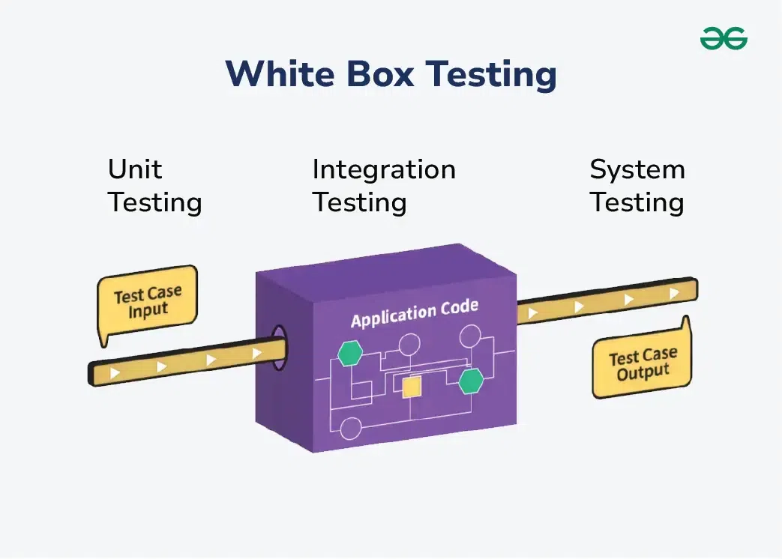

Slide 15
Basic Path Testing
  Basic path testing is a white-box testing technique that ensures all independent paths in a program are executed at least once. It is based on the program’s control flow and helps identify logical errors.
  It uses a concept called Cyclomatic Complexity to determine the number of independent paths.
  Key Points
    Focuses on independent execution paths
    Uses control flow graph (CFG)
    Helps in designing effective test cases
    Ensures complete path coverage
  Importance
    Detects logical and structural errors
    Ensures better code coverage

Slide 16
Path Testing Process
  Path Testing process is the technique where the test cases are designed to cover all possible paths within the program's control flow. The goal is to ensure that every independent execution path is tested. Path testing typically follows four steps:
    Construct the Control Flow Graph.
    Compute the Cyclomatic Complexity of the Graph.
    Identify the Independent Paths.
    Design Test cases from Independent Paths.

Slide 17
Control Structure Testing
  Control structure testing is another white-box testing method that focuses on testing different control structures used in a program, such as conditions and loops.
  Types of Control Structure Testing
  a) Condition Testing
    Tests logical conditions (true/false)
    Ensures all possible outcomes are checked
  b) Loop Testing
    Tests loops for correct execution
    Checks boundary conditions (0, 1, many iterations)
  c) Data Flow Testing
    Focuses on variables (definition and usage)
    Ensures proper data handling
Key Points
Verifies program logic
Ensures correctness of conditions and loops
Improves reliability

Slide 18
Black-Box Testing Techniques
  Black-box testing is a testing technique where the internal structure of the program is not known. Testing is based only on inputs and expected outputs. It focuses on validating the functionality of the software.
  Key Points
    No knowledge of internal code required
    Focuses on requirements and functionality
    Performed by testers
  Common Black-Box Testing Techniques
    1. Equivalence Partitioning
    Input data is divided into groups (valid and invalid), and one value from each group is tested.
    Reduces number of test cases.

Slide 19
2. Boundary Value Analysis
Tests values at the boundaries (minimum, maximum, just inside/outside limits).
Errors are common at boundaries.
3. Decision Table Testing
Uses a table to represent different conditions and actions.
Useful for complex logic.
4. State Transition Testing
Tests system behavior for different states and transitions.
Useful for systems with multiple states (e.g., login systems).

Slide 20
Types of Software Maintenance
  Software maintenance refers to the process of modifying and updating software after delivery to fix issues, improve performance, or adapt to changes.
  There are four main types of maintenance:
  1. Corrective Maintenance
    Corrective maintenance is performed to fix errors or bugs found in the software after it has been deployed. These errors may be discovered by users or testers.
    Key Points
    Fixes defects and bugs
    Done after system deployment
    Improves system correctness
    Example: Fixing a login error in an application.

Slide 21
2. Adaptive Maintenance
  Adaptive maintenance is done to modify the software to work in a new or changing environment. This may include changes in hardware, operating systems, or business rules.
  Key Points
  Adapts software to new environments
  Required due to technology or platform changes
  Ensures compatibility ‘
  Example: Updating software to run on a new operating system.

Slide 22
3. Perfective Maintenance
  Perfective maintenance focuses on improving the performance or adding new features to the system based on user feedback.
  Key Points
  Enhances performance and functionality
  Adds new features or improves existing ones
  Based on user requirements
  Example: Adding a new search feature to an application.

Slide 23
4. Preventive Maintenance
  Preventive maintenance is done to prevent future problems by improving the internal structure of the software.
  Key Points
  Reduces chances of future errors
  Improves code quality and maintainability
  Includes code optimization and refactoring
  Example: Refactoring code to make it cleaner and more efficient.

Slide 24
Enhancing Maintainability During Development
  Maintainability refers to how easily a software system can be modified, updated, or fixed after it is developed. Enhancing maintainability during development means designing and developing software in such a way that future changes can be made easily and efficiently.
  Good maintainability reduces cost, saves time, and improves software quality in the long run.
  How to Enhance Maintainability
  1. Follow Good Coding Standards
  Writing clean, consistent, and well-structured code makes it easier for developers to understand and modify the system later.
  2. Use Modular Design
  Divide the system into smaller modules with specific functions. This allows changes to be made in one module without affecting others.
  3. Maintain High Cohesion and Low Coupling
  Each module should perform a single task (high cohesion) and should not depend heavily on other modules (low coupling).

Slide 25
4. Proper Documentation
Provide clear documentation for code, design, and system functionality. This helps future developers understand the system easily.
5. Use Meaningful Naming Conventions
Variables, functions, and classes should have meaningful names to improve readability.
6. Code Reusability
Design components that can be reused. This reduces duplication and simplifies maintenance.
7. Regular Testing
Frequent testing helps identify and fix errors early, making the system more stable and easier to maintain.
8. Version Control
Using tools like Git helps track changes and manage different versions of the software.

Slide 26
9. Refactoring
Improving code structure without changing functionality helps keep the system clean and maintainable.
Benefits
  Easier bug fixing and updates
  Reduced maintenance cost
  Improved software quality
  Faster development of future enhancements
  Better understanding for new developers

Slide 27
Relationship Between Testing and Maintenance
  Testing and maintenance are closely related activities in the software development life cycle. After a software system is deployed, it enters the maintenance phase, where changes such as bug fixes, updates, and enhancements are made. Since these changes can introduce new errors, testing becomes essential to ensure the system continues to function correctly.
Relationship Explanation
  Maintenance involves modifying the software, while testing ensures that these modifications are correct, complete, and do not affect existing functionalities. Every change made during maintenance must be followed by appropriate testing. Thus, testing acts as a verification and validation mechanism during maintenance.
  Without proper testing, maintenance activities may degrade system performance or introduce new defects. Therefore, testing supports maintenance by maintaining the quality, reliability, and stability of the software.

Slide 28
Testing Activities During Maintenance
  1. Regression Testing
    Regression testing ensures that existing features continue to work correctly after changes are made. It is the most important testing activity during maintenance.
  2. Re-testing
  Re-testing is performed to confirm that previously identified defects have been fixed properly.
  3. Integration Testing
  Ensures that modified modules work correctly with other parts of the system.
  4. System Testing
  Tests the complete system after changes to ensure overall functionality and performance.

